Slide 1
Code Generation Lecture 14-15

Slide 2
Code Generation
The code generation problem is the task of mapping intermediate code to machine code.
Requirements:
Correctness
Must preserve semantic meaning of source program
Efficiency
Make effective use of available resources
Code Generator itself must run efficiently

Slide 3
Compiler Architecture
Syntactic
structure
Intermediate
Language
Intermediate
Language
tokens
Source
language
Scanner
(lexical
analysis)
Parser
(syntax
analysis)
Semantic
Analysis
(IC generator)
Code
Optimizer
Code
Generator
Target
language
Symbol
Table

Slide 4
Input to the Code Generator
We assume, front end has
Scanned, parsed and translate the source program into a reasonably detailed intermediate representations
Type checking, type conversion and obvious semantic errors have already been detected
Symbol table is able to provide run-time address of the data objects
Intermediate representations may be
Postfix notations
Three address representations
Syntax tree
DAG

Slide 5
Issues in the design of code generator
Input: Intermediate representation with symbol table
assume that input has been validated by the front end
target programs :
absolute machine language
fast for small programs
relocatable machine code
requires linker and loader
assembly code
requires assembler, linker, and loader
Notes:
Lets examine the generic issues in the design of code generators.
Input to the code generator: The input to the code generator consists of the intermediate representation of the source program produced by the front end, together with the information in the symbol table that is used to determine the runtime addresses of the data objects denoted by the names in the intermediate representation. We assume that prior to code generation the input has been validated by the front end i.e. type checking, syntax, semantics etc. have been taken care of. The code generation phase can therefore proceed on the assumption that the input is free of errors.
Target programs: The output of the code generator is the target program. This output may take a variety of forms; absolute machine language, relocatable machine language, or assembly language.
Producing an absolute machine language as output has the advantage that it can be placed in a fixed location in memory and immediately executed. A small program can be thus compiled and executed quickly.
Producing a relocatable machine code as output allows subprograms to be compiled separately. Although we must pay the added expense of linking and loading if we produce relocatable object modules, we gain a great deal of flexibility in being able to compile subroutines separately and to call other previously compiled programs from an object module.
Producing an assembly code as output makes the process of code generation easier as we can generate symbolic instructions. The price paid is the assembling, linking and loading steps after code generation.

Slide 6
Target Programs
The output of the code generator is the target program.
Target architecture: must be well understood
Significantly influences the difficulty of code generation
RISC, CISC
Target program may be
Absolute machine language
It can be placed in a fixed location of memory and immediately executed
Re-locatable machine language
Subprograms to be compiled separately
A set of re-locatable object modules can be linked together and loaded for execution by a linker

Slide 7
Issues in the Design of a Code Generator
Instruction Selection
Register Allocation
Evaluation Order

Slide 8
Instruction Selection
Instruction selection
uniformity
completeness
Instruction speed
Register allocation
Instructions with register operands are faster
store long life time and counters in registers
temporary locations
Even odd register pairs
Evaluation order
Notes:
The nature of the instruction set of the target machine determines the difficulty of instruction selection. The uniformity and completeness of the instruction set are important factors. So, the instruction selection depends upon:
Instructions used i.e. which instructions should be used in case there are multiple instructions that do the same job.
Uniformity i.e. support for different object/data types, what op-codes are applicable on what data types etc.
Completeness: Not all source programs can be converted/translated in to machine code for all architectures/machines. E.g. 80x86 doesn’t support multiplication.
Instruction Speed: This is needed for better performance.
Register Allocation:
Instructions involving registers are usually faster than those involving operands memory.
Store long life time values that are often used in registers.
Evaluation Order: The order in which the instructions will be executed. This increases performance of the code.

Slide 9
Instruction Selection
There may be a large number of ‘candidate’ machine instructions for a given IR instruction
Level of IR
High: Each IR translates into many machine instructions
Low: Reflects many low-level details of machine
Nature of the instruction set
Uniformity and completeness
Each has own cost and constraints
Accurate cost information is difficult to obtain
Cost may be influenced by surrounding context

Slide 10
Instruction Selection
straight forward code if efficiency is not an issue
a=b+c Mov b, R₀
d=a+e Add c, R₀
Mov R₀, a
Mov a, R₀ can be eliminated
Add e, R₀
Mov R₀, d
a=a+1 Mov a, R₀ Inc a
Add #1, R₀
Mov R₀, a
Notes:
Here is an example of use of instruction selection:
Straight forward code if efficiency is not an issue
a=b+c Mov b, R0
d=a+e Add c, R0
Mov R0, a
Mov a, R0 can be eliminated as a has the value of R0
Add e, R0
Mov R0, d
a=a+1 Mov a, R0 Inc a
Add #1, R0
Mov R0, a
Here, “Inc a” takes lesser time as compared to the other set of instructions as others take almost 3 cycles for each instruction but “Inc a” takes only one cycle. Therefore, we should use “Inc a” instruction in place of the other set of instructions.

Slide 11
Instruction Selection
a := b + c
d := a + e
MOV b, R0
ADD c, R0
MOV R0, a
MOV a, R0
ADD e, R0
MOV R0, d
MOV R0, a
If a is subsequently used
MOV a, R0

Slide 12
Instruction Selection
For each type of three-address statement, a code skeleton can be designed that outlines the target code to be generated for that construct.
Say, x := y + z
Mov y, R0
Add z, R0
Mov R0, x
Statement by statement code generation often produces poor code

Slide 13
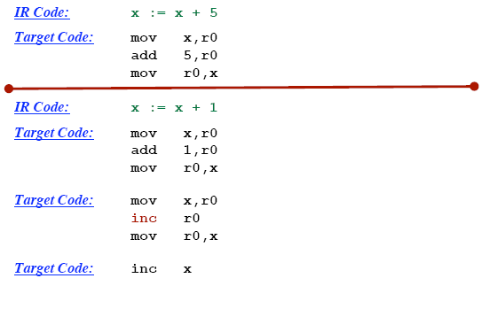
Instruction selection: Machine Idioms

Slide 14
Register Allocation
How to best use the bounded number of registers.
Use or registers
Register allocation
We select a set of variables that will reside in registers at each point in the program
Register assignment
We pick the specific register that a variable will reside in.
Complications:
special purpose registers
operators requiring multiple registers.
Optimal assignment is NP-complete

Slide 15
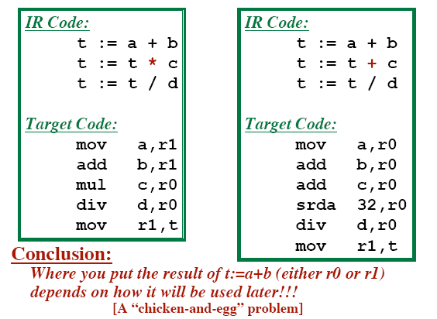
Register Allocation

Slide 16
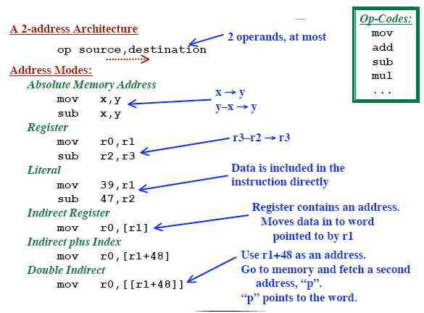
Example Target Machine

Slide 17
Target Machine
Byte addressable with 4 bytes per word
It has n registers R₀, R₁, ..., R_{n-l}
Two address instructions of the form
opcode source, destination
Usual opcodes like move, add, sub etc.
Addressing modes
MODE FORM ADDRESS
Absolute M M
register R R
index c(R) c+cont(R)
indirect register *R cont(R)
indirect index *c(R) cont(c+cont(R))
literal #c c
Notes:
Familiarity with the target machine and its instruction set is a prerequisite for designing a good code generator. Our target computer is a byte addressable machine with four bytes to a word and n general purpose registers, R₀, R₁,……R_{n-1}. It has two address instructions of the form
op source, destination
In which op is an op-code, and source and destination re data fields. It has the following op-codes among others:
MOV (move source to destination)
ADD (add source to destination)
SUB (subtract source from destination)
The source and destination fields are not long enough to hold memory addresses, so certain bit patterns in these fields specify that words following an instruction contain operands and/or addresses. The address modes together with their assembly-language forms are shown above.

Slide 18
Evaluation Order
Choosing the order of instructions to best utilize resources
Picking the optimal order is NP-complete problem
Simplest Approach
Don’t mess with re-ordering.
Target code will perform all operations in the same order as the IR code
Trickier Approach
Consider re-ordering operations
May produce better code
... Get operands into registers just before they are needed
... May use registers more efficiently

Slide 19
Moving Results Back to Memory
When to move results from registers back into memory?
After an operation, the result will be in a register.
Immediately
Move data back to memory just after it is computed.
May make more registers available for use elsewhere.
Wait as long as possible before moving it back
Only move data back to memory “at the end”
or “when absolutely necessary”
May be able to avoid re-loading it later!

Slide 20

Evaluating A Potential Code Sequence
Each instruction has a “cost”
Cost = Execution Time
Execution Time is difficult to predict.
Pipelining, Branches, Delay Slots, etc.
Goal: Approximate the real cost
A “Cost Model”

Slide 21
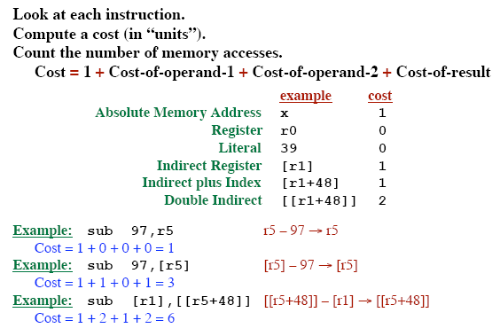
A Better Cost Model

Slide 22
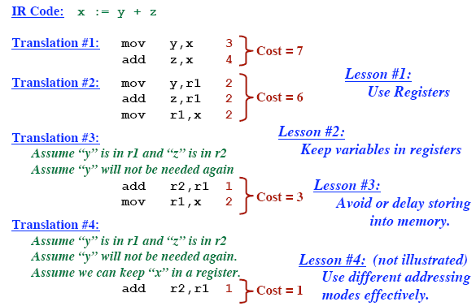
Cost Generation Example

Slide 23
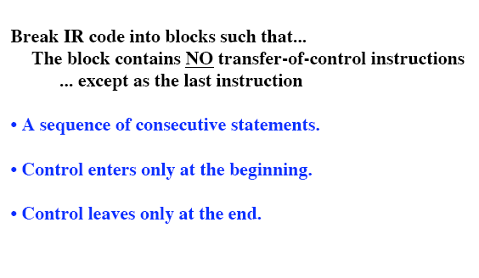
Basic Blocks

Slide 24
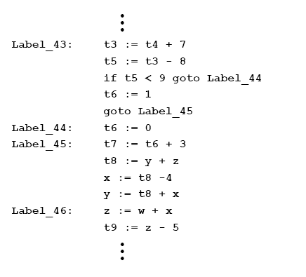
Basic Blocks

Slide 25
Basic blocks
sequence of statements in which flow of control enters at beginning and leaves at the end
Algorithm to identify basic blocks
determine leader
first statement is a leader
any target of a goto statement is a leader
any statement that follows a goto statement is a leader
for each leader its basic block consists of the leader and all statements up to next leader
Notes:
A basic block is a sequence of consecutive statements in which flow of control enters at the beginning and leaves at the end without halt or possibility of branching except at the end. The following algorithm can be used to partition a sequence of three-address statements into basic blocks:
We first determine the set of leaders, the first statements of basic blocks. The rules we use are the following:
The first statement is a leader
Any statement that is the target of a conditional or unconditional goto is a leader.
Any statement that immediately follows a goto or conditional goto statement is a leader.
2. For each leader, its basic block consists of the leader and all statements up to but not including the next leader or the end of the program.

Slide 26
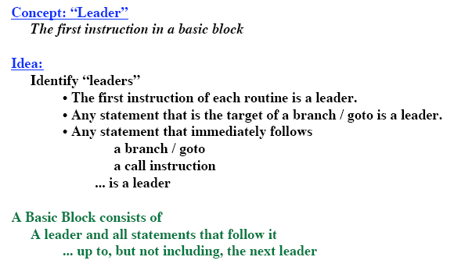
Algorithm to Partition Instructions into Basic Blocks

Slide 27
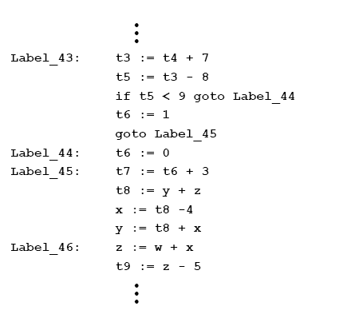
Identify Leaders – Example 1:

Slide 28
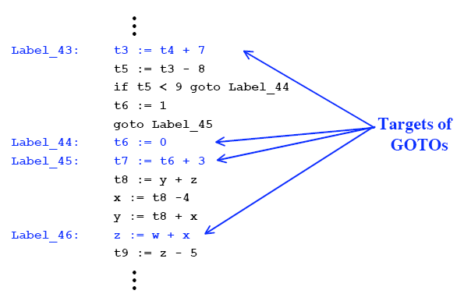
Identify Leaders – Example 1:

Slide 29
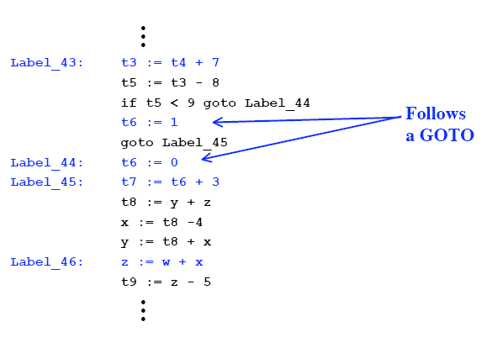
Identify Leaders – Example 1:

Slide 30
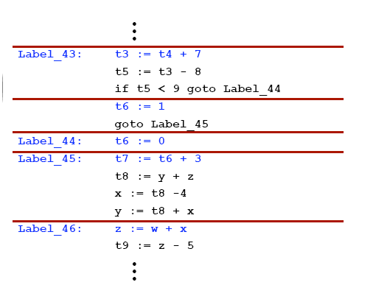
Identify Leaders

Slide 31
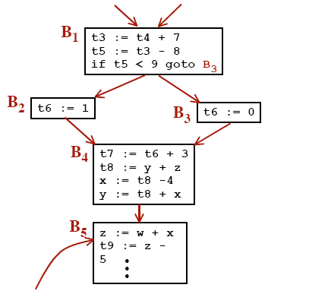
Control Flow Graph

Slide 32
Flow graphs
add control flow information to basic blocks
nodes are the basic blocks
there is a directed edge from B₁ to B₂ if B₂ can follow B₁ in some execution sequence
there is a jump from the last statement of B₁ to the first statement of B₂
B₂ follows B₁ in natural order of execution
initial node: block with first statement as leader
Notes:
We can add flow control information to the set of basic blocks making up a program by constructing a directed graph called a flow graph. The nodes of a flow graph are the basic nodes. Once node is distinguished as initial; it is the block whose leader is the first statement. There is a directed edge from block B₁ to block B₂ if B₂ can immediately follow B₁ in some execution sequence; that is, if
There is conditional or unconditional jump from the last statement of B₁ to the first statement of B₂, or
B₂ immediately follows B₁ in the order of the program, and B₁ does not end in an unconditional jump.
We say that B₁ is the predecessor of B₂, and B₂ is a successor of B₁.

Slide 33
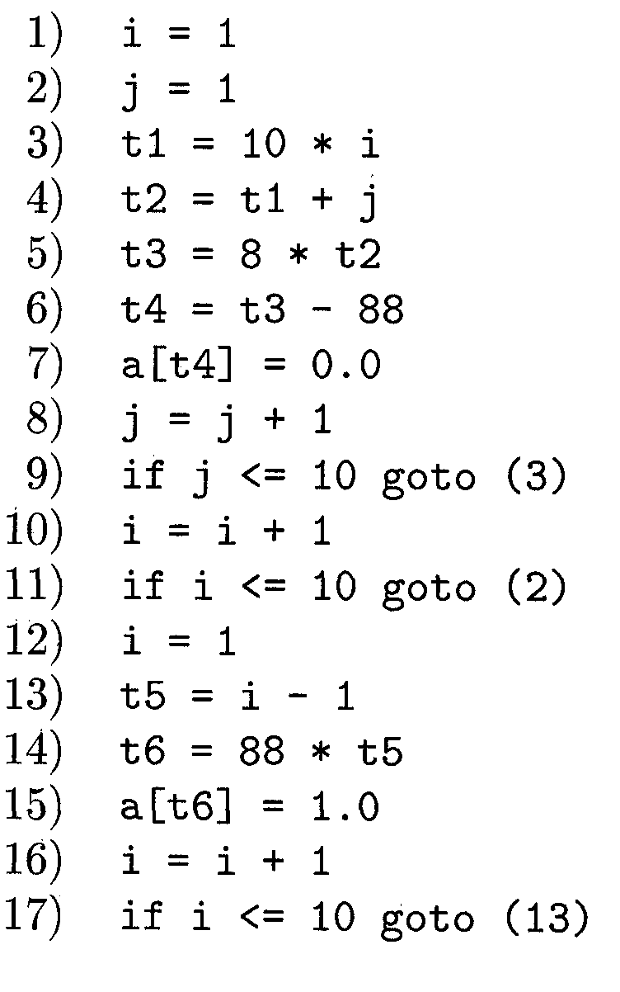
Identify Leaders – Example 2:

Slide 34
Identify Leaders – Example 2:
According to rule 1 : 1
According to rule 2 : 3, 2, 13
According to rule 3 : 10, 12

Slide 35
Basic block identification
We may use the following algorithm to find the basic blocks in a program:
Search header statements of all the basic blocks from where a basic block starts:
First statement of a program.
Statements that are target of any branch (conditional/unconditional).
Statements that follow any branch statement.
Header statements and the statements following them form a basic block.
A basic block does not include any header statement of any other basic block.

Slide 36
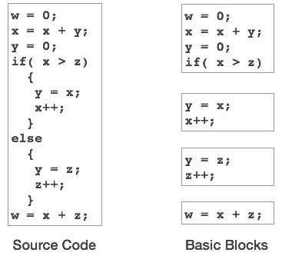
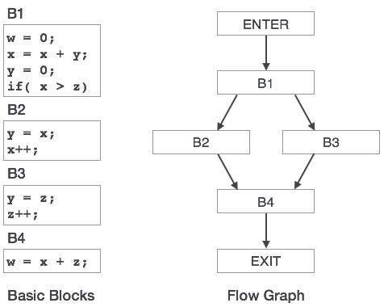

Slide 37
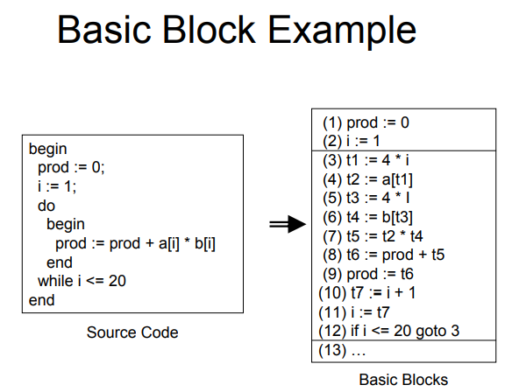

Slide 38
Code optimization
Elimination of unnecessary instructions
Replacement of one sequence of instructions by a faster sequence of instructions
Local optimization
Global optimizations
based on data flow analyses

Slide 39
Next use information
for register and temporary allocation
remove variables from registers if not used
statement X = Y op Z
defines X and uses Y and Z
scan each basic blocks backwards
assume all temporaries are dead on exit and all user variables are live on exit
Notes:
The use of a name in a three-address statement is defined as follows. Suppose three-address statement i assigns a value to x. If statement j has x as an operand, and control can flow from statement i to j along a path that has no intervening assignments to x, then we say statement j uses the value of x computed at i.
We wish to determine for each three-address statement x := y op z what the next uses of x, y and z are. We collect next-use information about names in basic blocks. If the name in a register is no longer needed, then the register can be assigned to some other name. This idea of keeping a name in storage only if it will be used subsequently can be applied in a number of contexts. It is used to assign space for attribute values. The simple code generator applies it to register assignment. Our algorithm to determine next uses makes a backward pass over each basic block, recording (in the symbol table) for each name x whether x has a next use in the block and if not, whether it is live on exit from that block. We can assume that all non-temporary variables are live on exit and all temporary variables are dead on exit.

Slide 40
Algorithm to compute next use information
Suppose we are scanning
i : X := Y op Z in backward scan
attach to i, information in symbol table about X, Y, Z
set X to not live and no next use in symbol table
set Y and Z to be live and next use in i in symbol table
Notes:
As an application, we consider the assignment of storage for temporary names.
Suppose we reach three-address statement i: x := y op z in our backward scan. We then do the following:
Attach to statement i the information currently found in the symbol table regarding the next use and live ness of x, y and z.
In the symbol table, set x to “not live” and “no next use”.
In the symbol table, set y and z to “live” and the next uses of y and z to i. Note that the order of steps (2) and (3) may not be interchanged because x may be y or z.
If three-address statement i is of the form x := y or x := op y, the steps are the same as above, ignoring z.

Slide 41
Themes behind Optimization Techniques
Avoid redundancy: something already computed need not be computed again
Smaller code: less work for CPU, cache, and memory!
Less jumps: jumps interfere with code pre-fetch
Code locality: codes executed close together in time is generated close together in memory – increase locality of reference
Extract more information about code: More info – better code generation

Slide 42
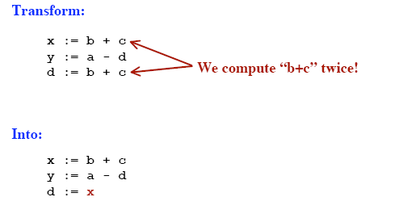
Common Sub-Expression Elimination

Slide 43
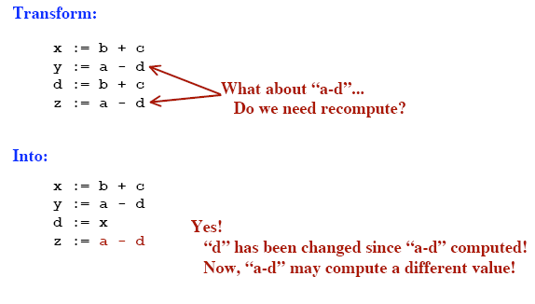
Common Sub-Expression Elimination

Slide 44
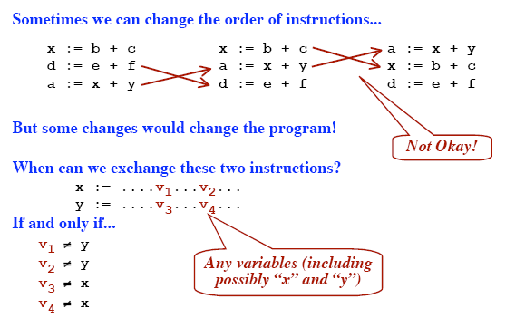
Reordering Instructions in a Basic Block

Slide 45
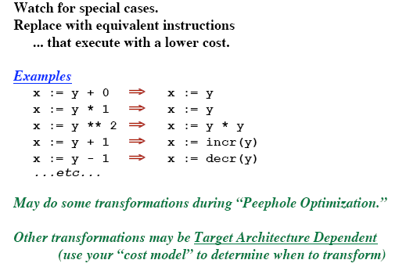
Algebraic Transformation

Slide 46
Usage of Machine idioms
Use machine specific hardware instruction which may be less costly.
i := i + 1
ADD i, #1 INC i

Slide 47
Replace Multiply by Shift
A := A * 4;
Can be replaced by 2-bit left shift (signed/unsigned)
But must worry about overflow if language does
A := A / 4;
If unsigned, can replace with shift right
But shift right arithmetic is a well-known problem
Language may allow it anyway (traditional C)

Slide 48
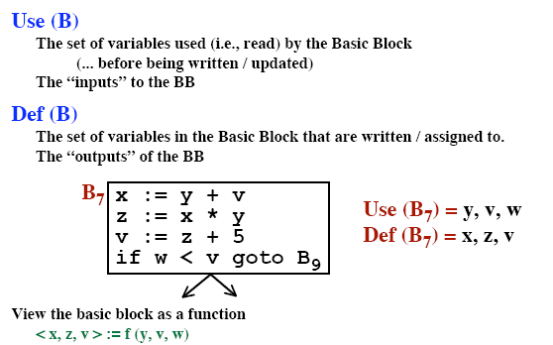
Look at Each Basic Block in Isolation

Slide 49
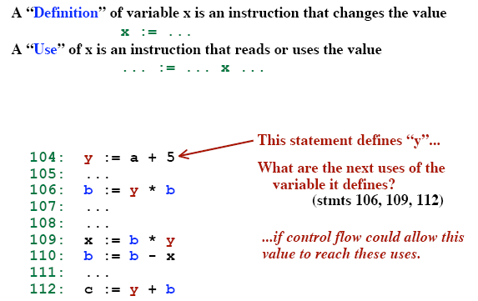
Definition and Use of variables

Slide 50
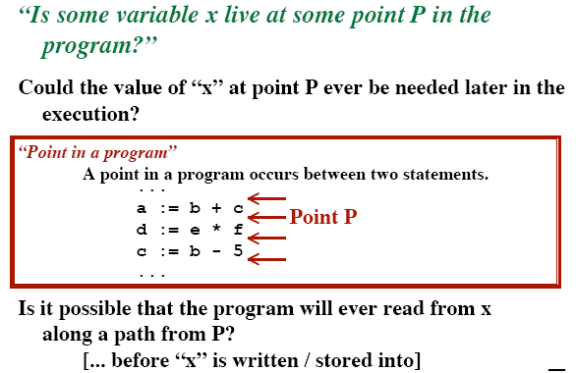
Live Variables

Slide 51
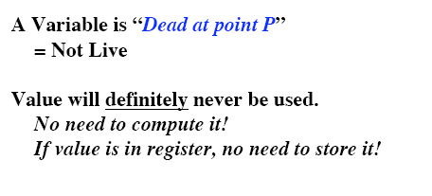
Dead Variables

Slide 52
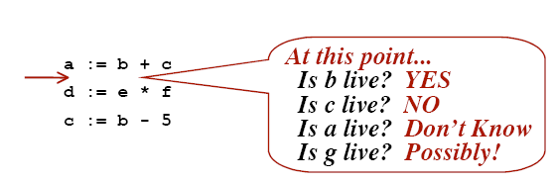
Liveness Example

Slide 53
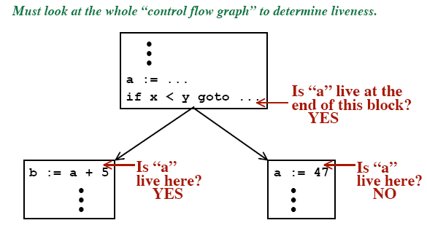
Liveness Example

Slide 54
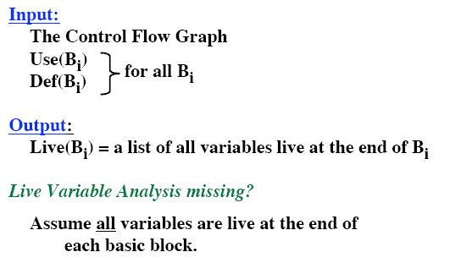
Live Variable Analysis

Slide 55
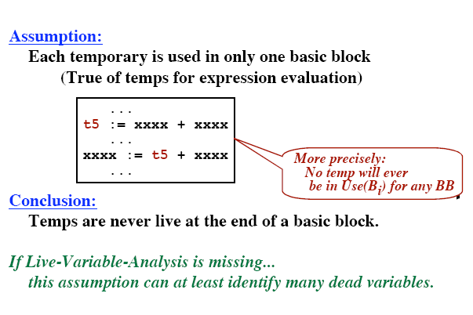
Temporaries

Slide 56
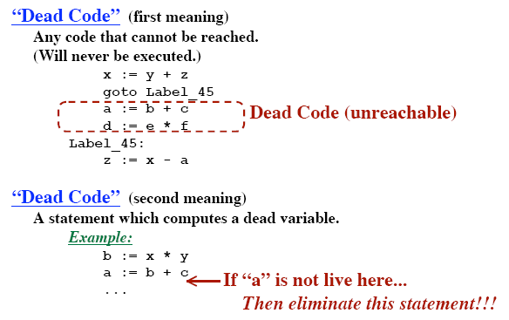
Dead Code

Slide 57
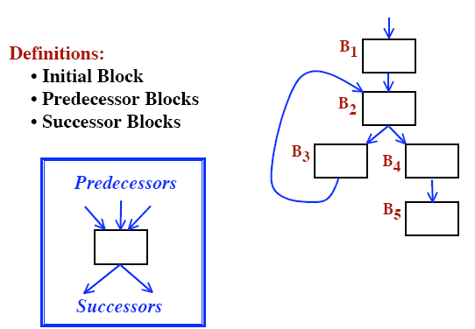
Control Flow Graphs

Slide 58
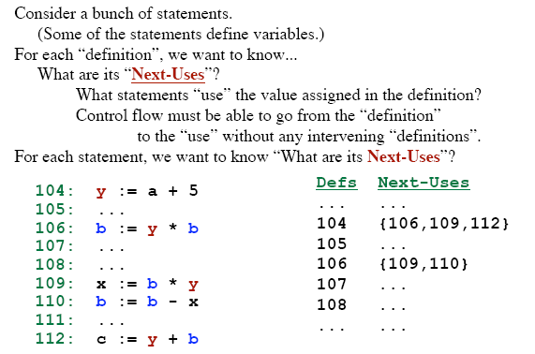
The “Next-Use” Information

Slide 59
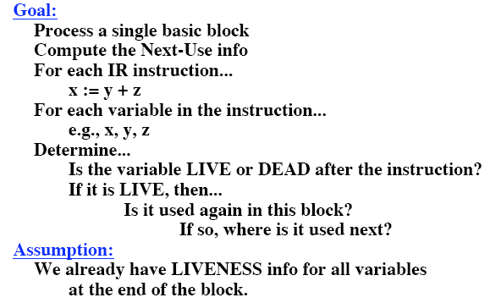
The “Next-Use” Algorithm

Slide 60
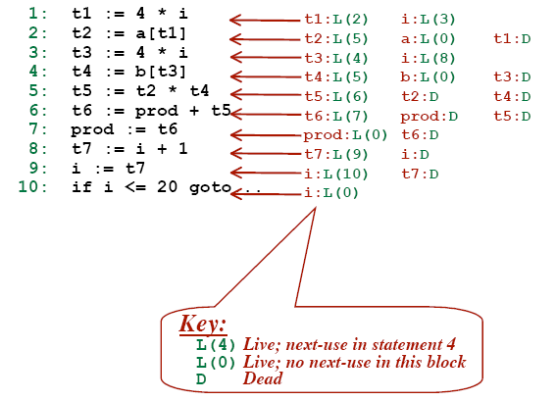
“Next-Use” Example

Slide 61
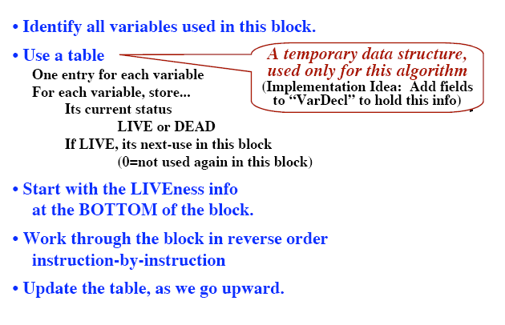
“Next-Use” Algorithm

Slide 62
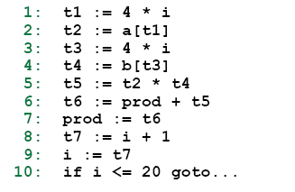
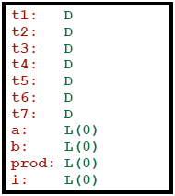
“Next-Use” Algorithm - Example

Slide 63
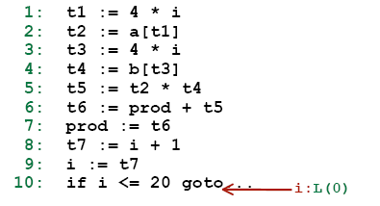
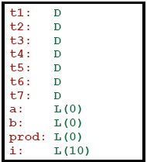
“Next-Use” Algorithm - Example

Slide 64
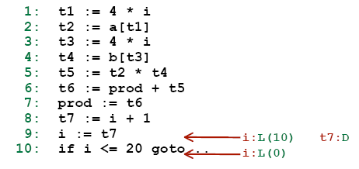
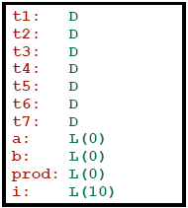
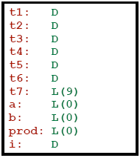
“Next-Use” Algorithm - Example

Slide 65
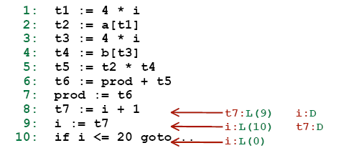
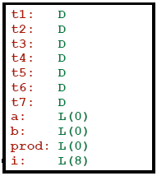
“Next-Use” Algorithm - Example

Slide 66
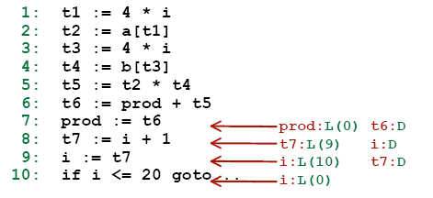
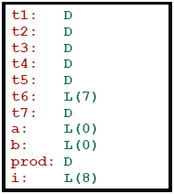
“Next-Use” Algorithm - Example

Slide 67
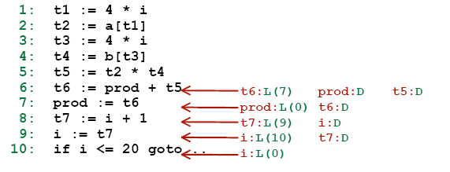
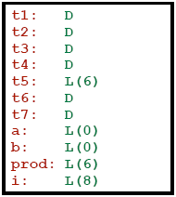
“Next-Use” Algorithm - Example

Slide 68
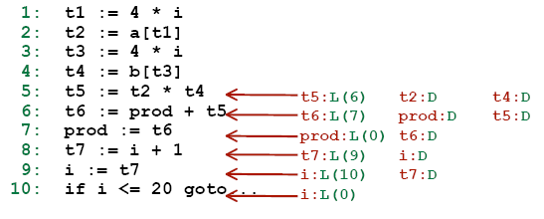
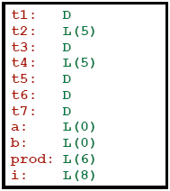
“Next-Use” Algorithm - Example

Slide 69


“Next-Use” Algorithm - Example

Slide 70


“Next-Use” Algorithm - Example

Slide 71


“Next-Use” Algorithm - Example

Slide 72



“Next-Use” Algorithm - Example
D
L ( 1 )

Slide 73

“Next-Use” Algorithm - Example

Slide 74

Data Needed during Code Generation

Slide 75
Example
1: t₁ = a * a
2: t₂ = a * b
3: t₃ = 2 * t₂
4: t₄ = t₁ + t₃
5: t₅ = b * b
6: t₆ = t₄ + t₅
7: X = t₆
Symbol Table
t₁
t₂
t₃
t₄
t₅
t₆
dead
Use in 4
STATEMENT
7: no temporary is live
6: t₆:use(7), t₄ t₅ not live
5: t₅:use(6)
4: t₄:use(6), t₁ t₃ not live
3: t₃:use(4), t₂ not live
2: t₂:use(3)
1: t₁:use(4)
dead
Use in 3
dead
Use in 4
dead
Use in 6
dead
Use in 6
dead
Use in 7
Notes:
We can allocate storage locations for temporaries by examining each in turn and assigning a temporary to the first location in the field for temporaries that does not contain a live temporary. If a temporary cannot be assigned to any previously created location, add a new location to the data area for the current procedure. In many cases, temporaries can be packed into registers rather than memory locations, as in the next section.

Slide 76
Example …
1
2
t₁
1: t₁ = a * a
2: t₂ = a * b
3: t₂ = 2 * t₂
4: t₁ = t₁ + t₂
5: t₂ = b * b
6: t₁ = t₁ + t₂
7: X = t₁
t₂
3
t₃
4
5
t₄
t₅
6
t₆
7
Notes:
The six temporaries in the basic block can be packed into two locations. These locations correspond to t₁ and t₂ in:
1: t₁ = a * a
2: t₂ = a * b
3: t₂ = 2 * t₂
4: t₁ = t₁ + t₂
5: t₂ = b * b
6: t₁ = t₁ + t₂
7: X = t₁

Slide 77
Code Generator
consider each statement
remember if operand is in a register
Register descriptor
Keep track of what is currently in each register.
Initially all the registers are empty
Address descriptor
Keep track of location where current value of the name can be found at runtime
The location might be a register, stack, memory address or a set of those
Notes:
The code generator generates target code for a sequence of three-address statement. It considers each statement in turn, remembering if any of the operands of the statement are currently in registers, and taking advantage of that fact, if possible. The code-generation uses descriptors to keep track of register contents and addresses for names.
A register descriptor keeps track of what is currently in each register. It is consulted whenever a new register is needed. We assume that initially the register descriptor shows that all registers are empty. (If registers are assigned across blocks, this would not be the case). As the code generation for the block progresses, each register will hold the value of zero or more names at any given time.
An address descriptor keeps track of the location (or locations) where the current value of the name can be found at run time. The location might be a register, a stack location, a memory address, or some set of these, since when copied, a value also stays where it was. This information can be stored in the symbol table and is used to determine the accessing method for a name.

Slide 78
Code Generation Algorithm
for each X = Y op Z do
invoke a function getreg to determine location L where X must be stored. Usually L is a register.
Consult address descriptor of Y to determine Y'. Prefer a register for Y'. If value of Y not already in L generate
Mov Y', L
Generate
op Z', L
Again prefer a register for Z. Update address descriptor of X to indicate X is in L. If L is a register update its descriptor to indicate that it contains X and remove X from all other register descriptors.
If current value of Y and/or Z have no next use and are dead on exit from block and are in registers, change register descriptor to indicate that they no longer contain Y and/or Z.
Notes:
The code generation algorithm takes as input a sequence of three-address statements constituting a basic block. For each three-address statement of the form x := y op z we perform the following actions:
Invoke a function getreg to determine the location L where the result of the computation y op z should be stored. L will usually be a register, but it could also be a memory location. We shall describe getreg shortly.
Consult the address descriptor for u to determine y’, (one of) the current location(s) of y. Prefer the register for y’ if the value of y is currently both in memory and a register. If the value of u is not already in L, generate the instruction MOV y’, L to place a copy of y in L.
Generate the instruction OP z’, L where z’ is a current location of z. Again, prefer a register to a memory location if z is in both. Update the address descriptor to indicate that x is in location L. If L is a register, update its descriptor to indicate that it contains the value of x, and remove x from all other register descriptors.
If the current values of y and/or y have no next uses, are not live on exit from the block, and are in registers, alter the register descriptor to indicate that, after execution of x := y op z, those registers no longer will contain y and/or z, respectively.

Slide 79
Function getreg
If Y is in register (that holds no other values) and Y is not live and has no next use after
X = Y op Z
then return register of Y for L.
2. Failing (1) return an empty register
Failing (2) if X has a next use in the block or op requires register then get a register R, store its content into M (by Mov R, M) and use it.
4. else select memory location X as L
Notes:
The function getreg returns the location L to hold the value of x for the assignment x := y op z.
If the name y is in a register that holds the value of no other names (recall that copy instructions such as x := y could cause a register to hold the value of two or more variables simultaneously), and y is not live and has no next use after execution of x := y op z, then return the register of y for L. Update the address descriptor of y to indicate that y is no longer in L
Failing (1), return an empty register for L if there is one.
Failing (2), if x has a next use in the block, or op is an operator such as indexing, that requires a register, find an occupied register R. Store the value of R into memory location (by MOV R, M) if it is not already in the proper memory location M, update the address descriptor M, and return R. If R holds the value of several variables, a MOV instruction must be generated for each variable that needs to be stored. A suitable occupied register might be one whose datum is referenced furthest in the future, or one whose value is also in memory.
If x is not used in the block, or no suitable occupied register can be found, select the memory location of x as L.

Slide 80
Example
Stmt code reg desc addr desc
t₁=a-b mov a,R₀ R₀ contains t₁ t₁ in R₀
sub b,R₀
t₂=a-c mov a,R₁ R₀ contains t₁ t₁ in R₀
sub c,R₁ R₁ contains t₂ t₂ in R₁
t₃=t₁+t₂ add R₁,R₀ R₀ contains t₃ t₃ in R₀
R₁ contains t₂ t₂ in R₁
d=t₃+t₂ add R₁,R₀ R₀ contains d d in R₀
mov R₀,d d in R₀ and
memory
Notes:
For example, the assignment d := (a - b) + (a - c) + (a - c) might be translated into the following three-address code sequence:
t₁ = a – b
t₂ = a – c
t₃ = t₁ + t₂
d = t₃ + t₂
The code generation algorithm that we discussed would produce the code sequence as shown. Shown alongside are the values of the register and address descriptors as code generation progresses.

Slide 81
Conditional Statements
branch if value of R meets one of six conditions negative, zero, positive, non-negative, non-zero, non-positive
if X < Y goto Z Mov X, R0
Sub Y, R0
Jmp negative Z
Condition codes: indicate whether last quantity computed or loaded into a location is negative, zero, or positive
Notes:
Machines implement conditional jumps in one of two ways.
One way is to branch if the value of a designated register meets one of the six conditions: negative, zero, positive, non-negative, non-zero, and non-positive. On such a machine a three-address statement such as if x < y goto z can be implemented by subtracting y from x in register R, and then jumping to z if the value in register is negative.
A second approach, common to many machines, uses a set of condition codes to indicate whether the last quantity computed or loaded into a register is negative, zero or positive.

Slide 82
Conditional Statements …
Compare instruction: sets the codes without actually computing the value
Cmp X, Y sets condition codes to positive if X > Y and so on
if X < Y goto Z Cmp X, Y
CJL Z
maintain a condition code descriptor: tells the name that last set the condition codes
X =Y + Z Mov Y,R0
if X < 0 goto L Add Z, R0
Mov R0, X
CJN L
Notes:
A compare instruction has the property that it sets the condition code without actually computing the value. That is, CMP x, y sets the condition code to positive if x > y, and so on. A conditional jump machine instruction makes the jump if a designated condition <, =, >, ≥, ≤ or ≠ is met. For example, if x < y goto z could be implemented by
CMP x, y
CJ< z
If we are generating code for a machine with condition codes it is useful to maintain a condition-code descriptor as we generate code. This descriptor tells the name that last set the condition code, or the pair of names compared, if the condition code was last set that way. Thus we could implement
x := y + z
if x < 0 goto z
by
MOV Y,R0
ADD Z, R0
MOV R0, X
CJ< L

Slide 83
DAG representation of basic blocks
useful data structures for implementing transformations on basic blocks
gives a picture of how value computed by a statement is used in subsequent statements
good way of determining common sub-expressions
A dag for a basic block has following labels on the nodes
leaves are labeled by unique identifiers, either variable names or constants
interior nodes are labeled by an operator symbol
nodes are also optionally given a sequence of identifiers for labels
Notes:
DAG (Directed Acyclic Graphs) are useful data structures for implementing transformations on basic blocks. A DAG gives a picture of how the value computed by a statement in a basic block is used in subsequent statements of the block. Constructing a DAG from three-address statements is a good way of determining common sub-expressions (expressions computed more than once) within a block, determining which names are used inside the block but evaluated outside the block, and determining which statements of the block could have their computed value used outside the block. A DAG for a basic block is a directed cyclic graph with the following labels on nodes:
Leaves are labeled by unique identifiers, either variable names or constants. From the operator applied to a name we determine whether the l-value or r-value of a name is needed; most leaves represent r-values. The leaves represent initial values of names, and we subscript them with 0 to avoid confusion with labels denoting “current“ values of names as in (3) below.
Interior nodes are labeled by an operator symbol.
Nodes are also optionally given a sequence of identifiers for labels. The intention is that interior nodes represent computed values, and the identifiers labeling a node are deemed to have that value.

Slide 84
DAG representation: example
t₁ := 4 * i
t₂ := a[t₁]
t₃ := 4 * i
t₄ := b[t₃]
t₅ := t₂ * t₄
t₆ := prod + t₅
prod := t₆
t₇ := i + 1
i := t₇
if i <= 20 goto (1)
t₆
prod
+
prod₀
*
t₅
(1)
t₄
t₂
[ ]
[ ]
<=
t₁
t₃
a
b
*
+
t₇
i
20
4
i₀
1
Notes:
For example, the slide shows a three-address code. The corresponding DAG is shown. We observe that each node of the DAG represents a formula in terms of the leaves, that is, the values possessed by variables and constants upon entering the block. For example, the node labeled t₄ represents the formula
b[4 * i]
that is, the value of the word whose address is 4*i bytes offset from address b, which is the intended value of t₄.

Slide 85
Code Generation from DAG
S₁ = 4 * i
S₂ = addr(A)-4
S₃ = S₂[S₁]
S₄ = 4 * i
S₅ = addr(B)-4
S₆ = S₅[S₄]
S₇ = S₃ * S₆
S₈ = prod+S₇
prod = S₈
S₉ = I+1
I = S₉
If I <= 20 goto (1)
S₁ = 4 * i
S₂ = addr(A)-4
S₃ = S₂[S₁]
S₅ = addr(B)-4
S₆ = S₅[S₄]
S₇ = S₃ * S₆
prod = prod + S₇
I = I + 1
If I <= 20 goto (1)
Notes:
We see how to generate code for a basic block from its DAG representation. The advantage of doing so is that from a DAG we can more easily see how to rearrange the order of the final computation sequence than we can starting from a linear sequence of three-address statements or quadruples. If the DAG is a tree, we can generate code that we can prove is optimal under such criteria as program length or the fewest number of temporaries used. The algorithm for optimal code generation from a tree is also useful when the intermediate code is a parse tree.

Slide 86
Rearranging order of the code
Consider following basic block
t₁ = a + b
t₂ = c + d
t₃ = e –t₂
X = t₁ –t₃
and its DAG
X
-
t₁
t₃
+
-
e
t₂
a
b
+
c
d
Notes:
Here, we briefly consider how the order in which computations are done can affect the cost of resulting object code. Consider the basic block and its corresponding DAG representation as shown in the slide.

Slide 87
Rearranging order …
Rearranging the code as
t₂ = c + d
t₃ = e –t₂
t₁ = a + b
X = t₁ –t₃
gives
MOV c, R₀
ADD d, R₀
MOV e, R₁
SUB R₀, R₁
MOV a, R₀
ADD b, R₀
SUB R₁, R₀
MOV R₁, X
Three adress code for the DAG (assuming only two registers are available)
MOV a, R₀
ADD b, R₀
MOV c, R₁
ADD d, R₁
MOV R₀, t₁
MOV e, R₀
SUB R₁, R₀
MOV t₁, R₁
SUB R₀, R₁
MOV R₁, X
Register spilling
Register reloading
Notes:
If we generate code for the three-address statements using the code generation algorithm described before, we get the code sequence as shown (assuming two registers R0 and R1 are available, and only X is live on exit). On the other hand suppose we rearranged the order of the statements so that the computation of t₁ occurs immediately before that of X as:
t₂ = c + d
t₃ = e – t₂
t₁ = a + b
X = t₁ – t₃
Then, using the code generation algorithm, we get the new code sequence as shown (again only R0 and R1 are available). By performing the computation in this order, we have been able to save two instructions; MOV R0, t₁ (which stores the value of R0 in memory location t₁) and MOV t₁, R1 (which reloads the value of t₁ in the register R1).

Slide 88
Peephole Optimization
target code often contains redundant instructions and suboptimal constructs
examine a short sequence of target instruction (peephole) and replace by a shorter or faster sequence
peephole is a small moving window on the target systems
Notes:
A statement-by-statement code-generation strategy often produces target code that contains redundant instructions and suboptimal constructs. A simple but effective technique for locally improving the target code is peephole optimization, a method for trying to improve the performance of the target program by examining a short sequence of target instructions (called the peephole) and replacing these instructions by a shorter or faster sequence, whenever possible. The peephole is a small, moving window on the target program. The code in the peephole need not be contiguous, although some implementations do require this.

Slide 89
Peephole optimization examples…
Redundant loads and stores
Consider the code sequence
Move R₀, a
Move a, R₀
Instruction 2 can always be removed if it does not have a label.
Notes:
Now, we will give some examples of program transformations that are characteristic of peephole optimization:
Redundant loads and stores:
If we see the instruction sequence
Move R₀, a
Move a, R₀
We can delete instruction (2) because whenever (2) is executed, (1) will ensure that the value of a is already in register R0. Note that is (2) has a label, we could not be sure that (1) was always executed immediately before (2) and so we could not remove (2).

Slide 90
Peephole optimization examples…
Unreachable code
Consider following code sequence
#define debug 0
if (debug) {
print debugging info
}
this may be translated as
if debug = 1 goto L1
goto L2
L1: print debugging info
L2:
Eliminate jump over jumps
if debug <> 1 goto L2
print debugging information
L2:
Notes:
Another opportunity for peephole optimization is the removal of unreachable instructions.

Slide 91
Unreachable code example …
constant propagation
if 0 <> 1 goto L2
print debugging information
L2:
Evaluate boolean expression. Since if condition is always true the code becomes
goto L2
print debugging information
L2:
The print statement is now unreachable. Therefore, the code becomes
L2:

Slide 92
Peephole optimization examples…
flow of control: replace jump sequences
goto L1
…
…
L1 : goto L2
Simplify algebraic expressions
remove x := x+0 or x:=x*1
goto L2
…
…
L1: goto L2
by

Slide 93
Peephole optimization examples…
Strength reduction
Replace X^2 by X*X
Replace multiplication by left shift
Replace division by right shift
Use faster machine instructions
replace Add #1,R
by Inc R

Slide 94
Code Generator Generator
Code generation by tree rewriting
target code is generated during a process in which input tree is reduced to a single node
each rewriting rule is of the form
replacement → template { action}
where
replacement is a single node
template is a tree
action is a code fragment

Slide 95
Instruction set for a hypothetical machine
M
:=
R
+
R
+
R
^
R’
R
R’
d
R
R
R’
Move R’, R@
Add #d, R
Add R’, R
Move R’@, R
M
:=
R
+
R
^
R
d
Move #d, R
+
+
R’
R
^
+
d
R’
d
R
Move R’@(d), R
Move R’, R@(d)
d
R’
Add R’@(d), R

Slide 96
Example
IR tree for A:=B+C+9
:=
+
+
a
R₀
^
+
R₀ is the base
register
+
^
9
b
R₀
+
a, b, c are offsets of
Variables A, B, C
c
R₀

Slide 97
Example …
Generate
Move #a, R₁
:=
+
+
a
R₀
^
+
R₁
matches
move #d, R
+
^
9
b
R₀
+
c
R₀

Slide 98
Example …
Generate
Move #a, R₁
Add R₀, R₁
:=
+
+
+
R₁
R₀
^
+
R₁
R₀
R₁
matches
Add R’, R
+
^
9
b
R₀
+
c
R₀

Slide 99
Example …
Generate
Move #a, R₁
Add R₀, R₁
Add R₀@(b), R₂
:=
R₁
+
R₂
^
+
^
matches
Add R@(d), R’
+
+
^
9
b
R₀
b
R₀
+
c
R₀

Slide 100
Example …
Generate
Move #a, R₁
Add R₀, R₁
Add R₀@(b), R₂
Add R₀@(c), R₃
:=
R₁
+
R₂
+
R₃
^
9
matches
Add R@(d), R’
^
+
+
c
R₀
c
R₀

Slide 101
Example …
Generate
Move #a, R₁
Add R₀, R₁
Add R₀@(b), R₂
Add R₀@(c), R₃
Add #9, R₃
:=
R₁
+
R₂
+
R₃
9
R₃
9
matches
Add #d, R

Slide 102
Example …
Generate
Move #a, R₁
Add R₀, R₁
Add R₀@(b), R₂
Add R₀@(c), R₃
Add #9, R₃
Add R₃, R₂
:=
+
+
R₁
R₂
R₂
R₂
R₃
matches
Add R’, R
R₃

Slide 103
Example …
Generate
Move #a, R₁
Add R₀, R₁
Add R₀@(b), R₂
Add R₀@(c), R₃
Add #9, R₃
Add R₃, R₂
Move R₂, R₁@
M
:=
:=
R₁
R₂
R₁
R₂
matches
Add R’, R@

Slide 104
Example
Generate
Move #9, R₁
:=
+
+
a
R₀
^
+
+
9
9
^
R₁
matches
move #d, R
b
R₀
+
c
R₀

Slide 105
Example …
Generate
Move #9, R₁
Add R₀@(c), R₁
:=
+
+
a
R₀
^
+
+
R₁
^
R₁
^
matches
add R@(d), R’
b
R₀
+
+
c
R₀
c
R₀

Slide 106
Example …
Generate
Move #9, R₁
Add R₀@(c), R₁
Add R₀@(b), R₁
:=
+
+
+
R₁
^
R₀
^
R₁
a
R₁
+
matches
add R@(d), R’
+
b
R₀
b
R₀

Slide 107
Example …
Generate
Move #9, R₁
Add R₀@(c), R₁
Add R₀@(b), R₁
Move R₁, R₀@(a)
M
:=
+
+
R₁
R₁
R₀
matches
Move R, R’@(d)
a
R₀
a

Slide 108
Any Question ?

